Slide 1

Anti Drunk & Drive
Team Name: 3 Idiots
Presented By
M Sunil Kumar – 162N1A0552
Md Imdaad – 162N1A0559
M Vineeth – 162N1A0551
IoT Hackathon 2019

Slide 2
Problem Statement
Drunk and Drive is the major problem has caused a large number of the deaths and injuries resulting from road crashes.
One day while I’m returning from office a teenager was driving car by consuming alcohol and got hit , led to spot dead which was a terrific scene.
IoT Hackathon 2019

Slide 3
Customer Survey
Please do survey in Google or conduct offline survey, and understand how important the problem for them?
Alcohol Detection by using Arduino, alcohol sensor, buzzer, red and green LED’s. If a person is driving a vehicle by consuming alcohol it detects and blinks red led continuously and buzzer will be horn else the vehicle is keep on going and green led is on.
Reach to the customer who is facing this and talk to them, put testimonials here.
Give Online URL for us to validate your customer survey and the idea will be scrutinized more on this.
IoT Hackathon 2019

Slide 4
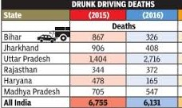
Existing Solutions
Yes there are existing solutions available in the market for anti drunk and drive.
Existing Solution : Alcohol Detection by using Raspberry pi, alcohol sensor. If a person is driving a vehicle by consuming alcohol it detects and buzzer will be horn else the vehicle is keep on going.
People rarely using this solution
We have identified from the existing solutions in related to the customer, they are not satisfied because of more cost (Raspberri pi)
IoT Hackathon 2019

Slide 5
Our Solution
A person was driving a vehicle by consuming alcohol , but here our project detects the alcohol and stops the vehicle by giving a warning(buzzer) sound.
That means by using our solution the customers can save their lives from dangerous road accidents.
Our solution is one of the best solution for giving the awareness to the customers from drunk and drive issues.
IoT Hackathon 2019

Slide 6
Value Proposition
Effective cost is the key point in the solution. Our solution is solving the pain of customer rather than spending more amount on raspberri pi product.
In the perspective of cost our project is more feasible to the customer than the existing solutions.
Effective cost attracts the customer to use your product than the existing product.
IoT Hackathon 2019

Slide 7
Customers & Consumers
Our solution is more useful for the customers who drives the vehicle by consumes alcohol frequently.
The one who consumes alcohol and drives a vehicle is only our customer.
The marketing of our product is done in vehicle companies.
IoT Hackathon 2019

Slide 8
Technology
The technology used in our project is Internet Of Things.
For programming we use simple C++ source code.
We use a software application called Arduino where we can write source code and upload it on the arduino board (hardware).
IoT Hackathon 2019

Slide 9
Product Hardware
The product hardware used in our project are
Different types of IOT(Internet Of Things) devices like
Arduino Uno Board,
Alcohol sensor,
Buzzer,
Red LED,
Green LED
IoT Hackathon 2019

Slide 10
Product Software
We use a software application called Arduino where we can write source code and upload it on the arduino board (hardware).
The technology used in our project is Internet Of Things.
For programming we use simple C++ source code.
IoT Hackathon 2019

Slide 11
Design & Development
Explain us the design of your product with blueprints or through block diagrams or photos of your design?
And, also explain us what you have built and show us the live demo of your project ?
If time permits, tell us what extra mile you can design or develop for making the product so catchy?
IoT Hackathon 2019

Slide 12
Cost & Revenue
Explain us for how much cost you are pleased to sell this product and also have you told the same cost in the customer survey or not?
Approximately, what would be the cost of end product which includes raw materials like hardware and software, marketing, production cost and tax?
What kind of revenues will be generated? How much scale of revenues will be generated for a period of 3 years?
IoT Hackathon 2019

Slide 13
Key Competitors
List out the key competitors who you would be competing with your product excellence?
What benefits you have in your product than the competitor and also quickly tell us what is your strategy in making it more powerful?
How you rate your solution/product from the end-user in related with competitor?
IoT Hackathon 2019

Slide 14
Results
Live Demo of your product/solution
Screenshots and Videos should be recorded after the successful completion of product and show us the same.
And, also tell us your hurdles in design and development and how you solved them?
IoT Hackathon 2019

Slide 15
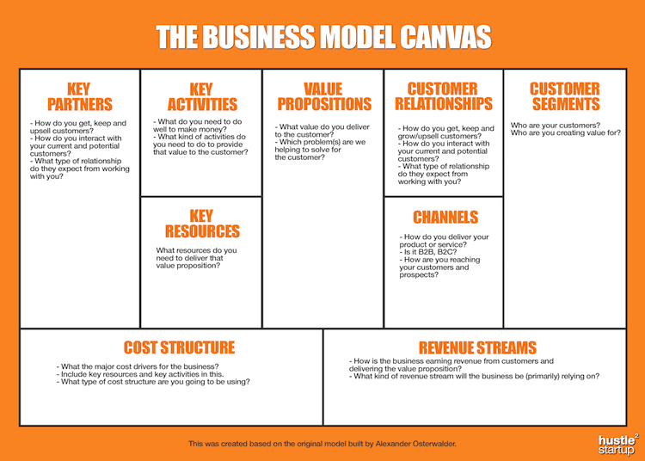
Business Model Canvas
IoT Hackathon 2019

Slide 16
Thank You! If you want to purchase/sponsor our solution/product, just mail us to teamspartans@gmail.com We are happy to hear your feedback as well, we would come back stronger!
IoT Hackathon 2019

